Slide 1
Human resources slide 1
HR Analytics

Slide 2
Human resources slide 2
AGENDA
Introduction
Analysis Process
Visualization

Slide 3


Introduction
This data on HR analytics, encompassing all employee-related activities on a yearly, quarterly, and monthly basis from 2011 to 2019. It includes comparative analyses to enhance clarity and understanding.

Slide 4

Analysis Process
Importing Data
Imported Data from SQL Server by using Power Query, we applied data wrangling techniques to cleanse, transform, and modify the data in line with our analysis requirements.

Slide 5
Analysis Process
Modelling Data
Using primary keys and foreign keys,
we established relationships between the tables, enabling a smooth filter path direction.

Slide 6
Analysis Process
Visualization
Additionally, we created calculated columns and measures, employing DAX (Data Analysis Expression) to calculate employee experience, age, the total number of terminated employees, and categorized terminations as voluntary or non-voluntary. For KPI (Key Performance Indicator) presentations, we utilized Single cards.

Slide 7
Visualization

Slide 8
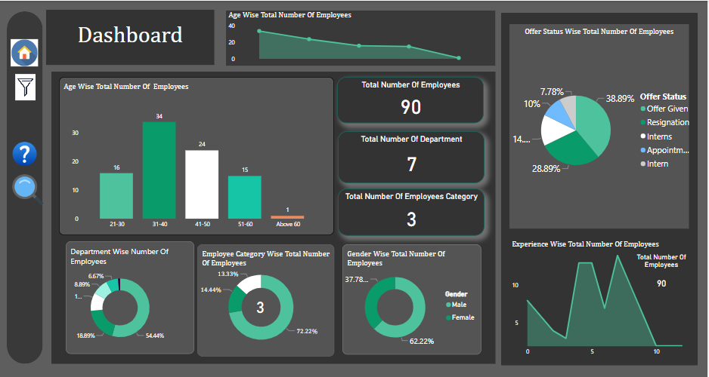

Slide 9
Human resources slide 4
KPI’S HUMAN RESOURCES:
Total Employees
TOTAL DEPARTMENTS
90
7
PROMOTED EMPLOYEES
TERMINATED EMPLOYEES
5
26
HUMAN RESOURCES

Slide 10
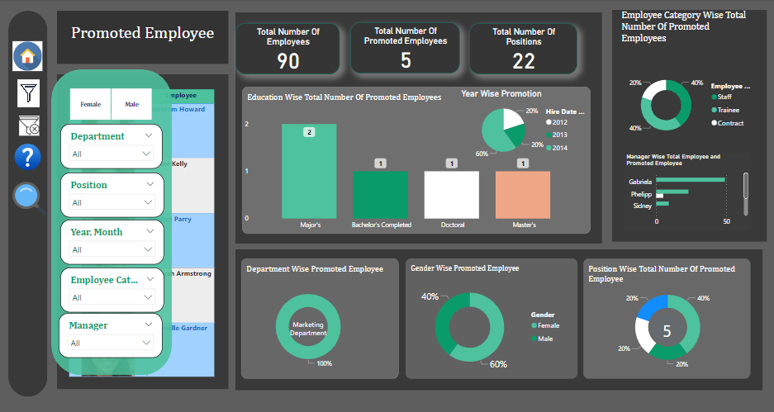

Slide 11

Human resources slide 7
HUMAN RESOURCES
5
60%
Female
40%
Male
1
TOTAL PROMOTED EMPLOYEES
Reporting Manager
Out of 90 employees, 5 employees were promoted from the marketing department
All of them reported to Phillip, who managed both the Marketing and Accounts departments.

Slide 12
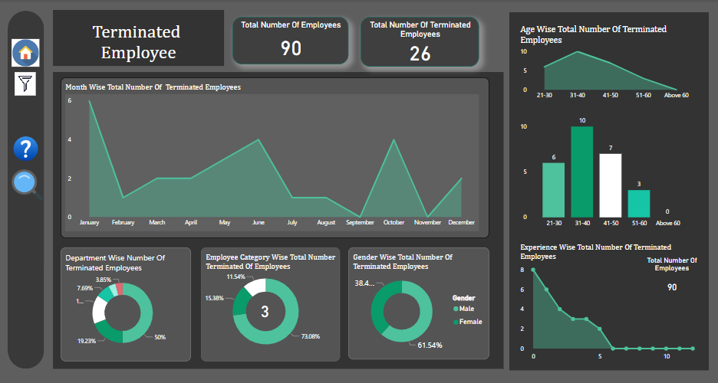

Slide 13
Human resources slide 7
HUMAN RESOURCES
26
61.54%
Male
38.46%
Female
1
TOTAL TERMINATED EMPLOYEES
Reporting Manager
Out of 90 employees, 26 employees were promoted from the marketing department
All of them reported to Phillip, who managed both the Marketing and Accounts departments.

Slide 14
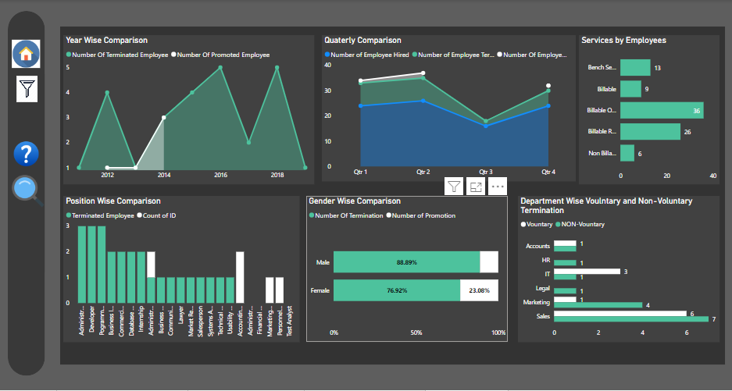
When comparing the terminated employees and promoted employees between 2011 and 2019, we can clearly conclude that in the years 2016 and 2018, the number of terminations was high. In both 2016 and 2018, 5 employees were terminated. In 2012, 4 employees were terminated, while in the marketing department, 1 employee was promoted. In 2014, the number of terminated employees was the same as the number of promoted employees, which was 3.
Examining the gender-wise comparison, it's clear that 16 male employees were terminated, while 10 female employees were terminated. The total number of promoted male employees was 2, but for females, it was 3.

Slide 15
Human resources slide 10
Thank You

